Slide 1
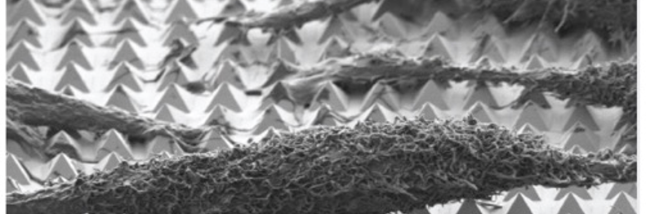
Determining the motion of a free falling chain
Syed Nabeel Shah | Julie Flores | Hans Johnson
Asim Gangopadhyaya

Slide 2
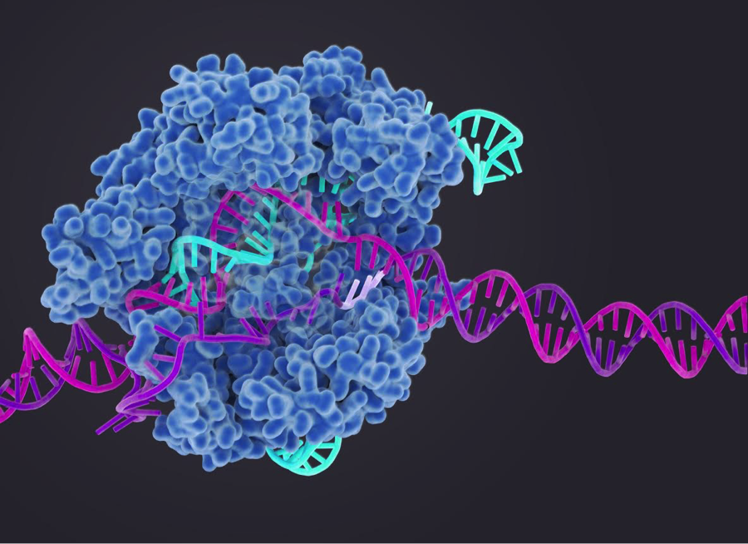
Problem / Question
Need: To determine the motion of a free falling chain in a controlled environment.

Slide 3
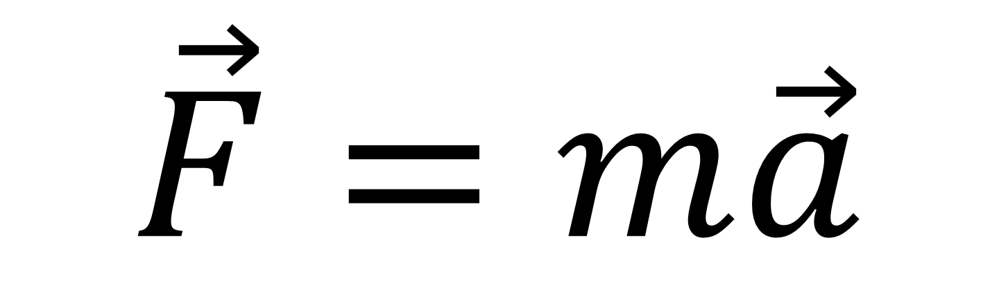
What should the motion of a free falling object be?
$$\vec{F}=m\vec{a}$$
Si (100)
Si (100)
Si (100)
Object
Si (100)
Si (100)
Notes:
Fabrication of structures with great control!– angle is 54.7 degrees (Si 100 plane bottom)
After e-beam
develop- 1:3 MIBK:IPA, 45 seconds @bench next to ebeam
IPA 5s, 3) druy air gun
2) Cr etch- take tall narrow glass beaker, use chromium etchant 1020. Etch rate 40 Angstroms per second at 40 deg C
etch time 5 second. 4nm/ s
DI water and N2 gun
3)Remove PMMA, acetone bath- put sample n acetone for 2.5 hours or overnight. In sonicator, IPA wash, dry N2 gun, plasma stripper (or not))
4)SiO2 etch (HF)49%HF 1: 10:H20, add HF to H2O, plastic cups
15seconds--- 6nm, DI washing– dry N2 gun, Dip and wash in big bath.
5)Si etch (KOH)
Using 30% KOH, mix 45% KOH with H2O to get 30%. Heat ti to 80 degrees, put KOH into water.
1min 30 seconds, 1100nm/min, DI water washing--- dry with N2 gun. Longer is okay
6)Cr etch (remove all the Cr)--- remove all chromium, DI water, dry N2 gun
7) Aqua Regia– 3HCl:HNO3:2H2O to remove nanoparticles

Slide 4
How Objects Actually Behave?
Insert Slinky video from YouTube to show how a long slinky behaves during a freefall.

Slide 5
Simulating a Chain with a masses tied to a string
Insert an image of the actual masses tied to a string, with 2 and 3 masses.

Slide 6
Predicting the motion of three masses tied to a string using Hamiltonian mechanics
Insert equations and matrices using office equation editor or LaTeX

Slide 7
Using Mathematica/Matlab to predict motion of more masses tied to a string
Insert parts of code/ working code to display the predictions.

Slide 8
Play video with masses and grid and explain prediction vs results
Next slides should display data points, percent errors, factors and future steps.

Slide 9
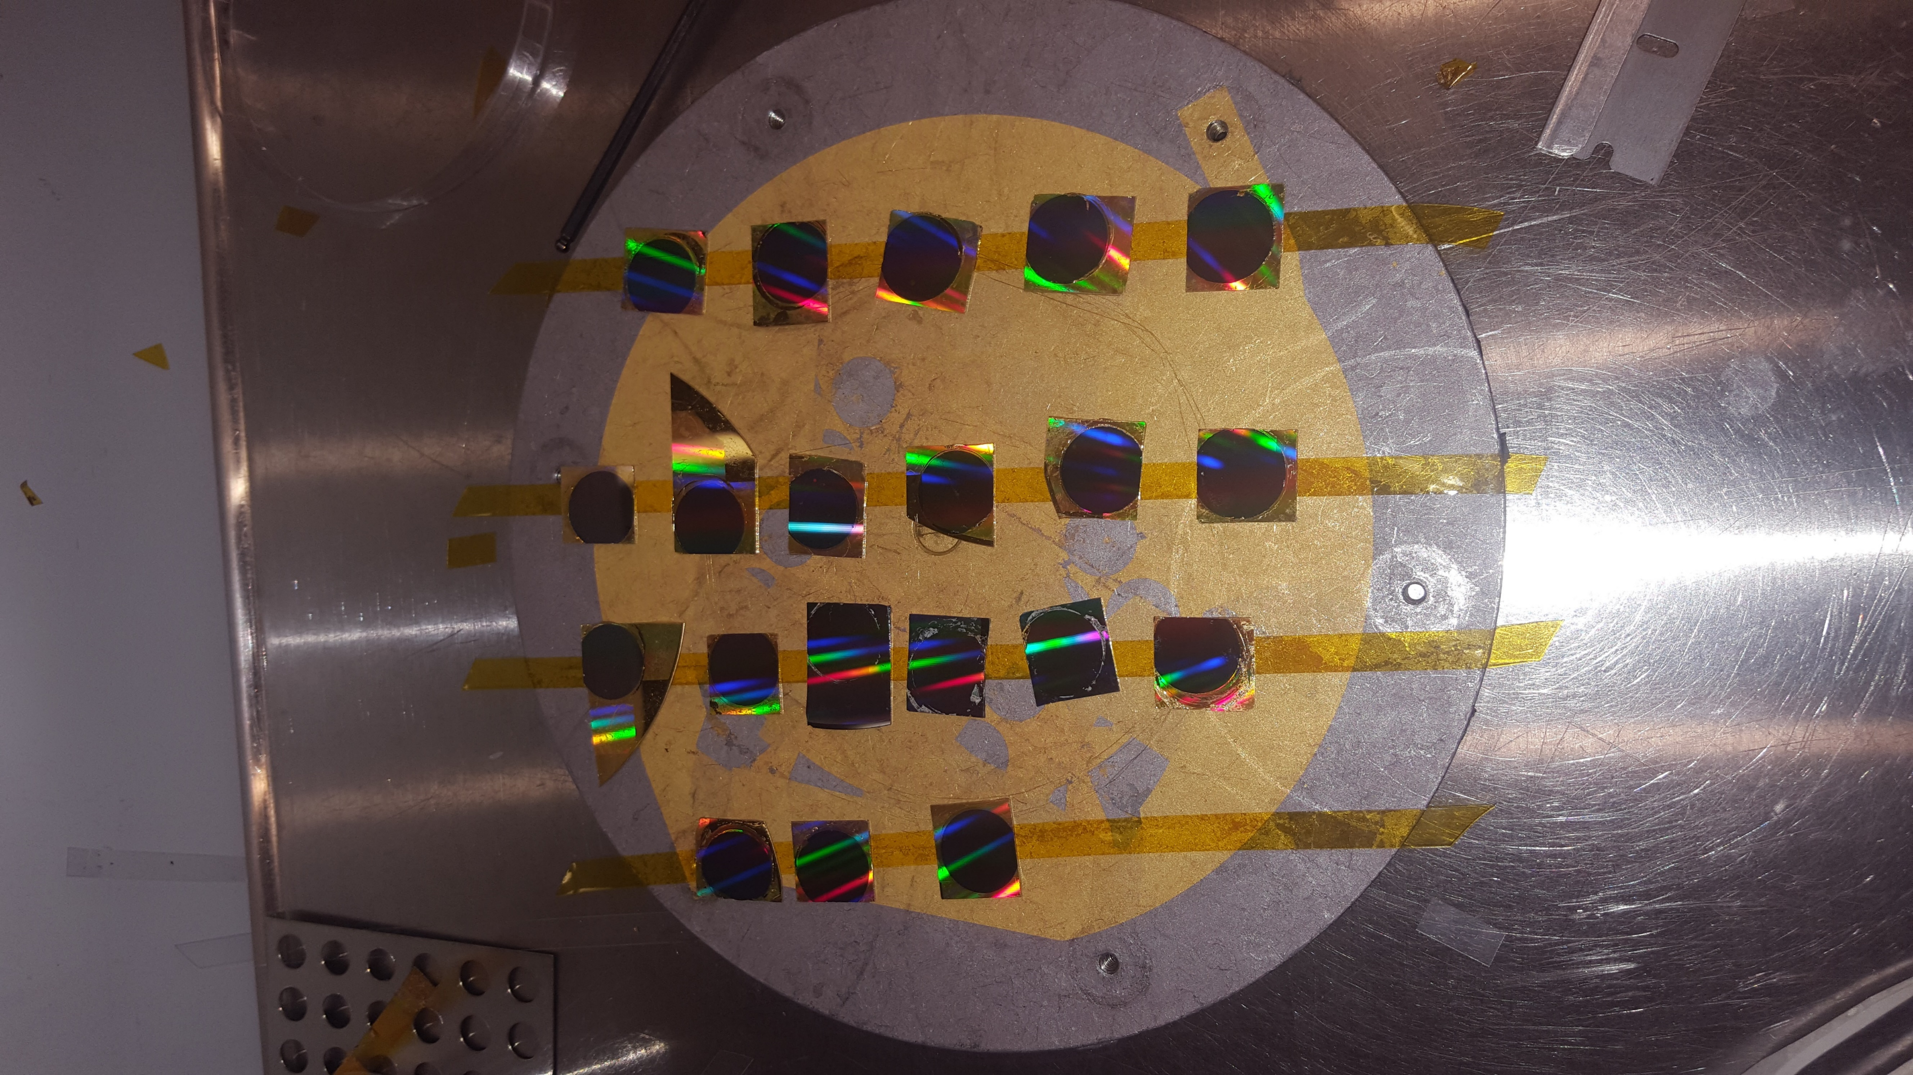

Slide 10
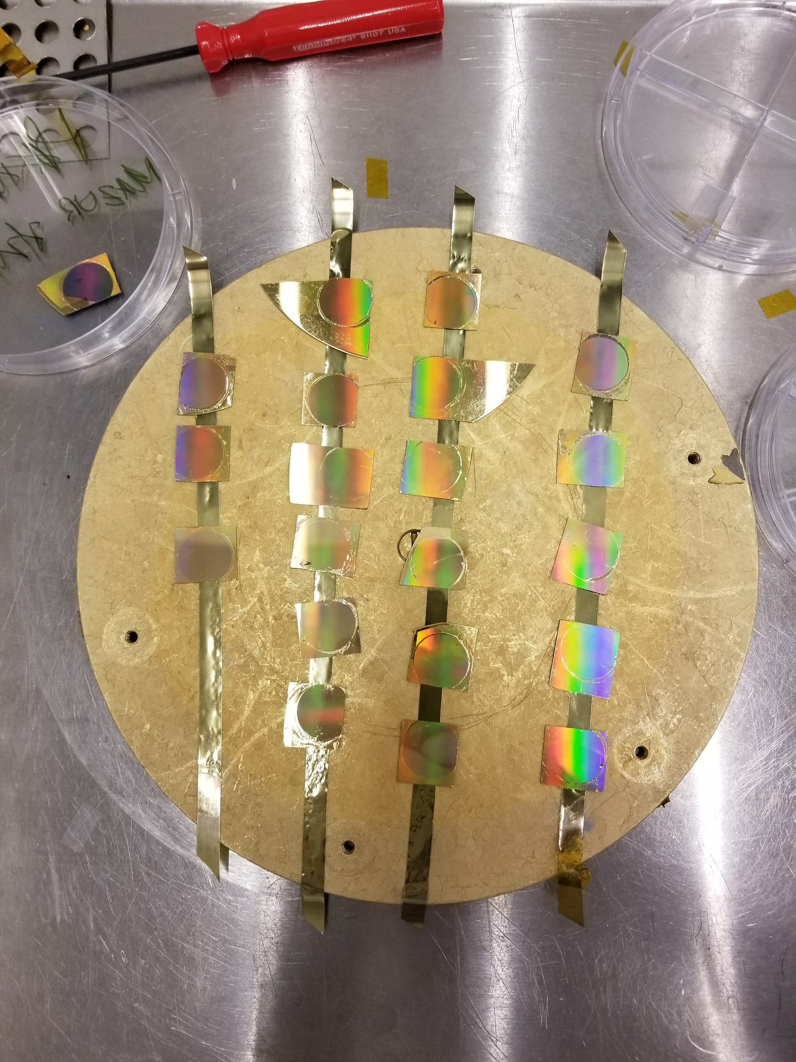
DEVICE

Slide 11
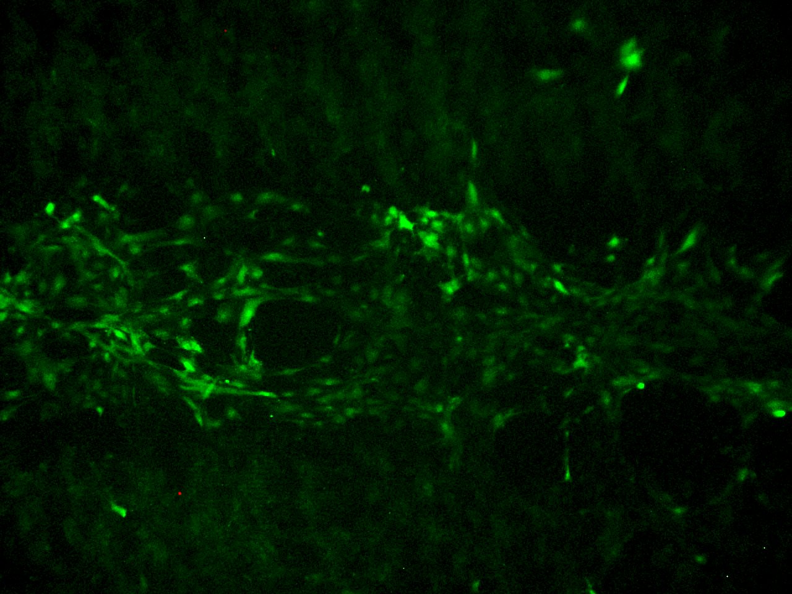
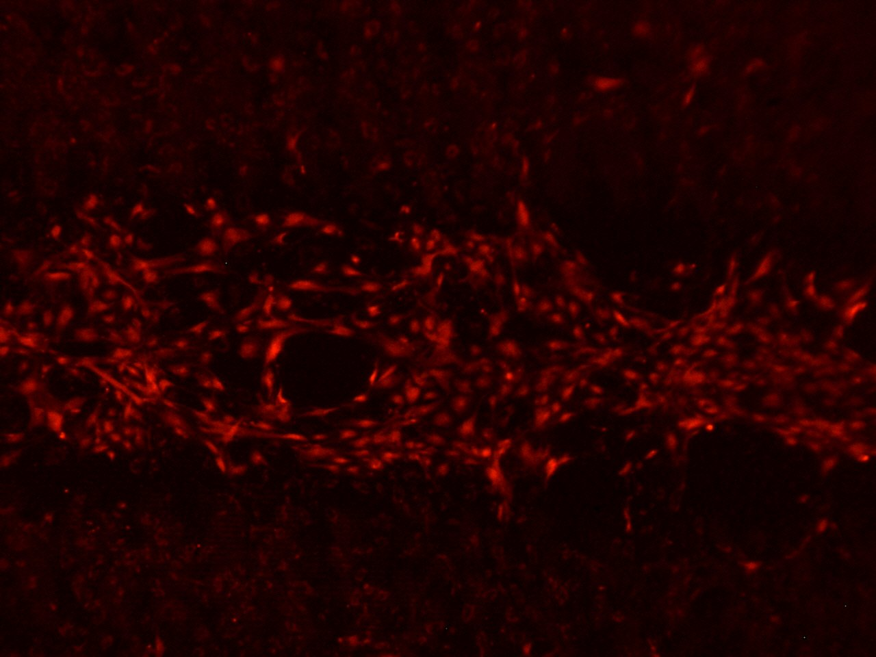
RERESULTS
Efficiency
Viability

Slide 12












NEXT STEPS

Slide 13








NEXT STEPS

Slide 14

NEXT STEPS

Slide 15




NEXT STEPS

Slide 16
NEXT STEPS

Slide 17
NEXT STEPS

Slide 18
NEXT STEPS

Slide 19
NEXT STEPS

Slide 20
NEXT STEPS

Slide 21





Acknowledgements

Slide 22
QUESTIONS/COMMENTS

